Slide 1
Going Analog
Sarah Rulon

Slide 2




Home Page
Introduction to
Bullet Journaling:
The journaling aspect
The planning aspect
The tracking aspect
How to Make One
for Yourself:
Supplies
Examples
Community

Slide 3

Home
Bullet Journals:
What are they good for?
Keeping Track
Journaling
Planning

Slide 4
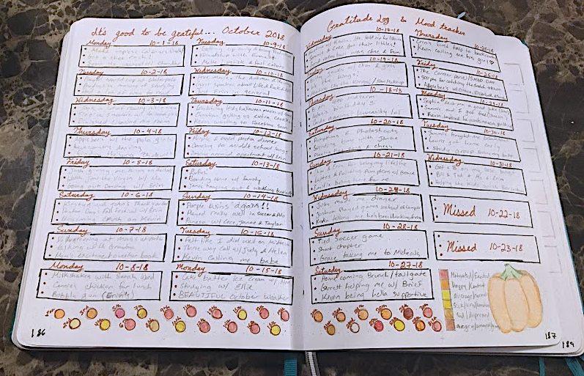
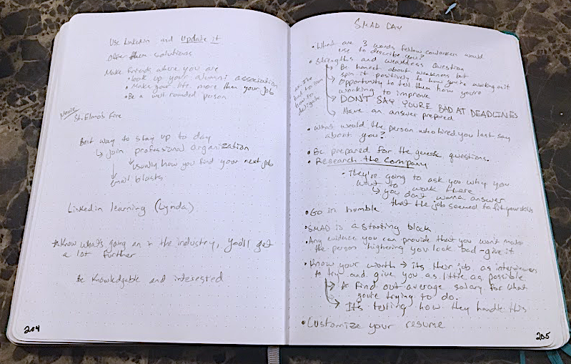
Home
Excellent for...
  Taking notes
  Writing quotes
  Keeping a daily journal
  Keeping a gratitude log
  Etc.
Journaling
Images by: Sarah Rulon

Slide 5
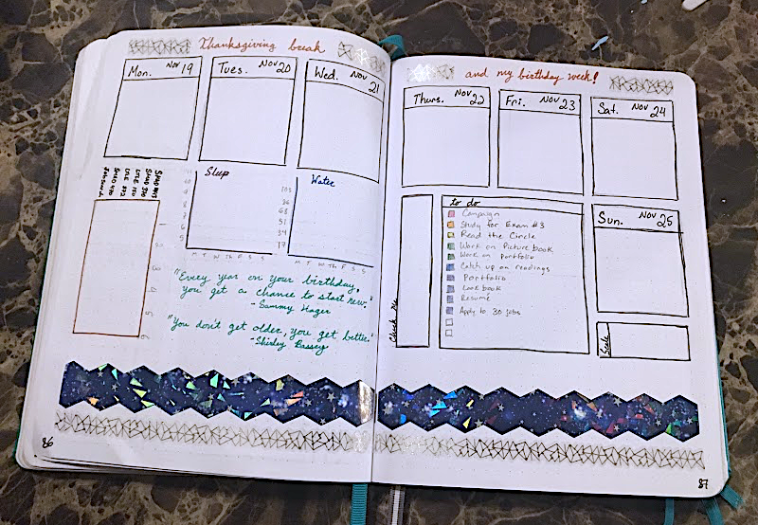
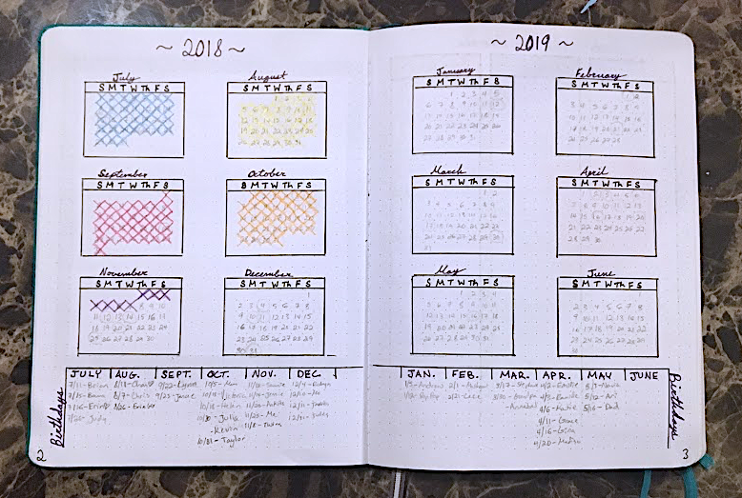
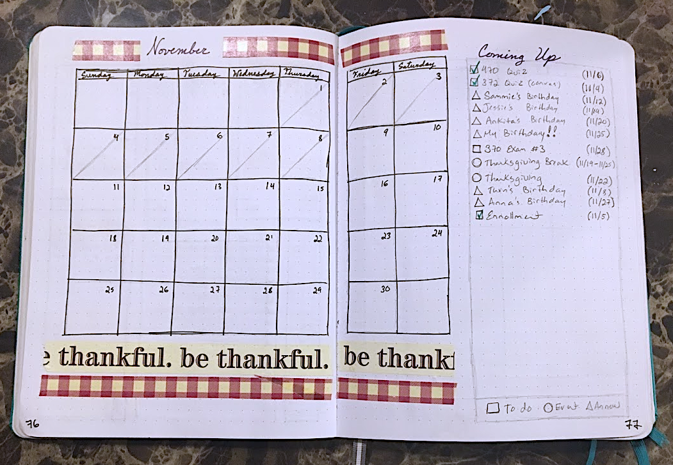
Home
Planning
Can be used as a...
  Calendar
  Weekly planner
  Day planner
  Etc.
Images by: Sarah Rulon

Slide 6
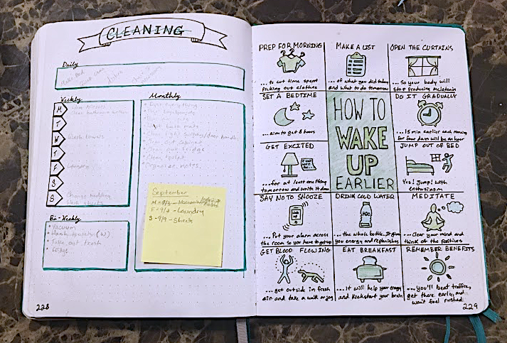
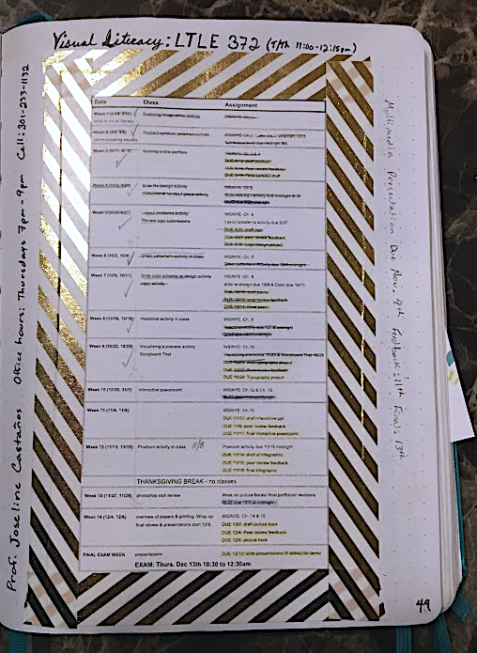
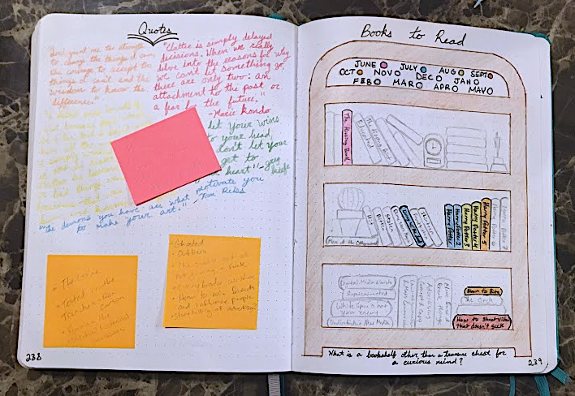
Home
Keeping Track
Images by: Sarah Rulon
You can also keep...
  To do lists
  Habit trackers
  To read/watch lists
  Chore lists
  Shopping lists
  The list goes on...

Slide 7

Home
Bullet Journals:
How do I make one?
Community
Supplies
Examples

Slide 8
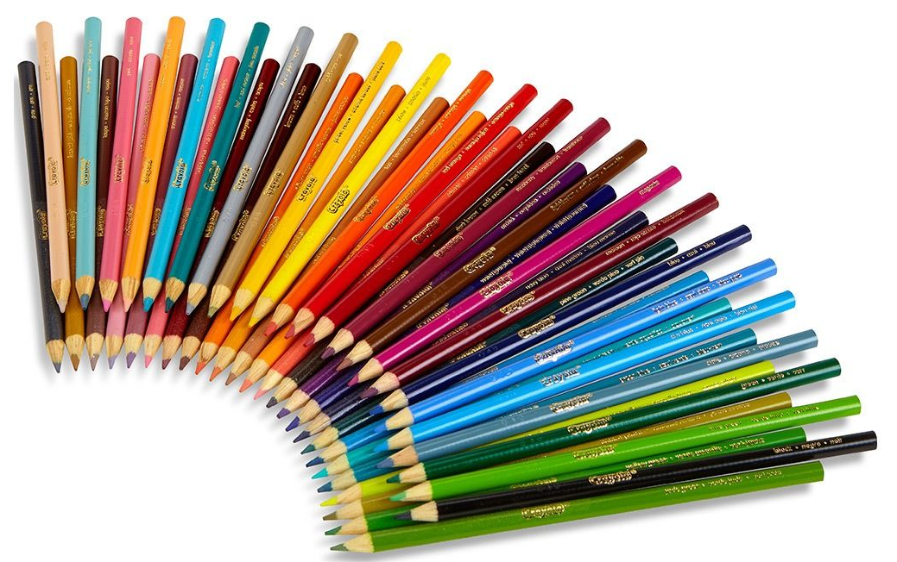
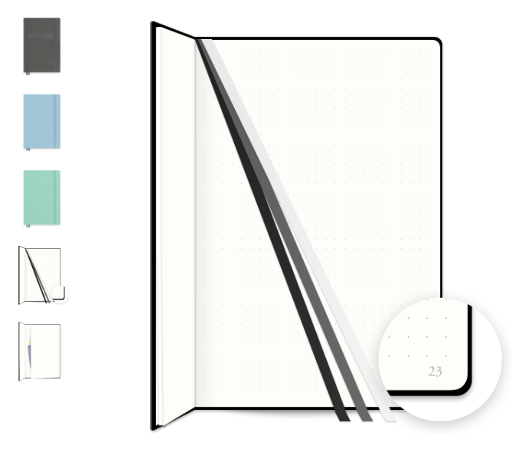
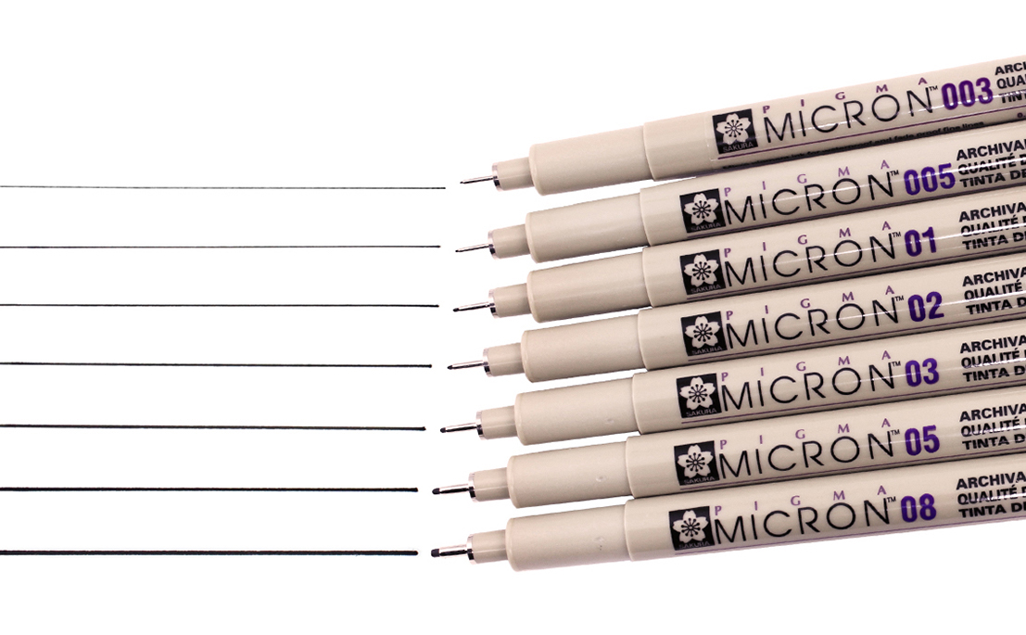
Home
Supplies
These are my preferred materials but all you need is any set of…
Colored pencils
Pens
A gridded notebook
Washi tape (optional)
(Click image for link to store site. Images also courtesy of store website where it is being sold.)

Slide 9
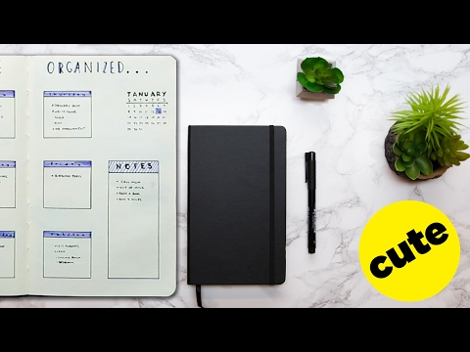
Home
Examples
An introduction to Bullet Journaling courtesy of Buzzfeed Nifty:
https://www.youtube.com/watch?v=nasMrmSumBU&t=2s

Slide 10
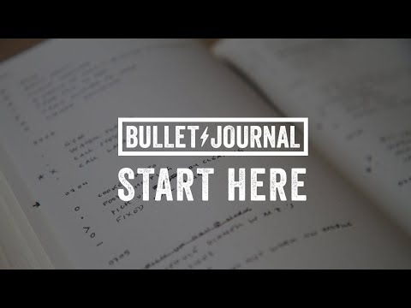
Home
Welcome to the Community
Good places to start:
Bulletjournal.com
Bullet Journal
BuzzFeed Nifty
Little Coffee Fox
Video credit to: Bullet Journal

